Slide 1


theknowledgeacademy
TOGAF® Enterprise Architecture Practitioner
Learning Studies
TOGAF Training Materials licensed from The Open Group. © 2022 The Open Group. All rights reserved. Reproduction and redistribution prohibited. The Open Group®, and TOGAF® are registered trademarks of The Open Group.
Copyright © The Open Group 2022
Notes:
TOGAF Enterprise Architecture Practitioner Bridge Courseware: Study materials leading to a TOGAF Enterprise Architecture Practitioner Certification

Slide 2

TOGAF EA Practitioner Learning Studies
A set of practical exercises
A mandatory element of all accredited training
To be used interactively either in class or remotely with feedback from the trainer
To be used in both TOGAF EA Practitioner and TOGAF EA Practitioner Bridge training
Students work their way through a storyline (a scenario) based around an organization undertaking a transformation
Can be undertaken individually or in groups
18 scenarios are presented, some place the individual in different roles (e.g. new architect vs senior architect)
Scenarios relate to sections of the syllabus
theknowledgeacademy
© The Knowledge Academy Ltd
Copyright © The Open Group 2022
Notes:
LO 8.2 The business scenario technique. KLP G176 §1, 3.1

Slide 3
Learning Studies Topics
Unit 1 — The Context for Enterprise Architecture (4 questions)
Unit 2 — Stakeholder Management (2 questions)
Unit 3 — Phase A, the Starting Point (2 questions)
Unit 4 — Architecture Development (3 questions)
Unit 5 — Implementing the Architecture (3 questions)
Unit 6 — Architecture Change Management (2 questions)
Unit 7 — Requirements Management (1 question)
Unit 8 — Supporting the ADM (1 question)
theknowledgeacademy
© The Knowledge Academy Ltd
Copyright © The Open Group 2022
Notes:
LO 8.2 The business scenario technique. KLP G176 §1, 3.1

Slide 4

TOGAF EA Practitioner Learning Studies
The Learning Studies are NOT a practice test
They must NOT be issued to students to take unsupervised
theknowledgeacademy
© The Knowledge Academy Ltd
Copyright © The Open Group 2022
Notes:
LO 8.2 The business scenario technique. KLP G176 §1, 3.1

Slide 5
TOGAF EA Practitioner Learning Studies
To accommodate all of the scenario questions, it is acceptable for cohorts to study a portion of the exercises in between training sessions
A minimum number of 10 scenario questions must be taught with the input of a trainer
All student work should be reviewed by the trainer /tutor and students should be able to discuss their answers, and the scenarios, to ensure they fully understand them
Applicable to all training course delivery methods
theknowledgeacademy
© The Knowledge Academy Ltd
Copyright © The Open Group 2022
Notes:
LO 8.2 The business scenario technique. KLP G176 §1, 3.1

Slide 6

TOGAF EA Practitioner Learning Studies
Individuals who are TOGAF Enterprise Architecture Practitioner certified and who have satisfactorily completed the TOGAF Enterprise Architecture Practitioner Learning Studies are eligible for the Applied Practitioner badge.
Accredited Training Course Providers are required to submit candidates to The Open Group (Contact atc-support@opengroup.org for a link to the web form for submission)
theknowledgeacademy
© The Knowledge Academy Ltd
Copyright © The Open Group 2022
Notes:
LO 8.2 The business scenario technique. KLP G176 §1, 3.1

Slide 7
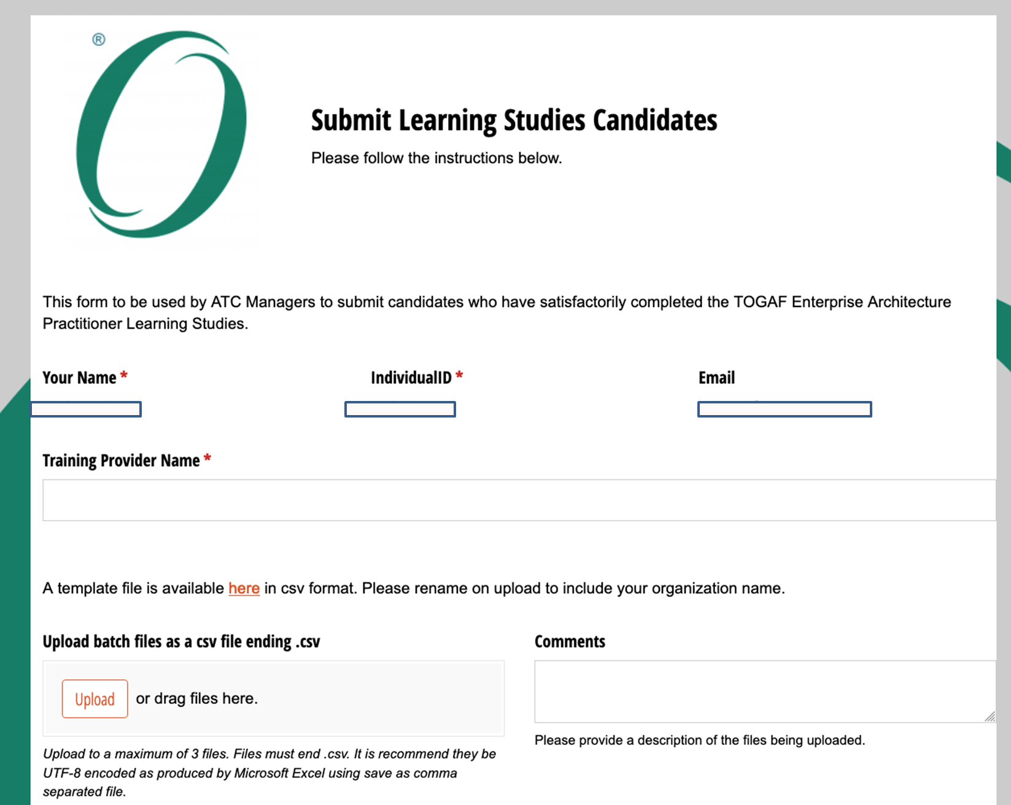
Web Submission Form
theknowledgeacademy
© The Knowledge Academy Ltd
Copyright © The Open Group 2022

Slide 8
Candidate ID
The Open Group requires the Candidate name, and Candidate ID to be submitted for students satisfactorily complete the Learning Studies Individuals need a web account for The Open Group in order to receive a Candidate ID Register at https://www.opengroup.org Candidate ID details are then available at https://www.opengroup.org/account-information
theknowledgeacademy
© The Knowledge Academy Ltd
Copyright © The Open Group 2022

